Slide 1
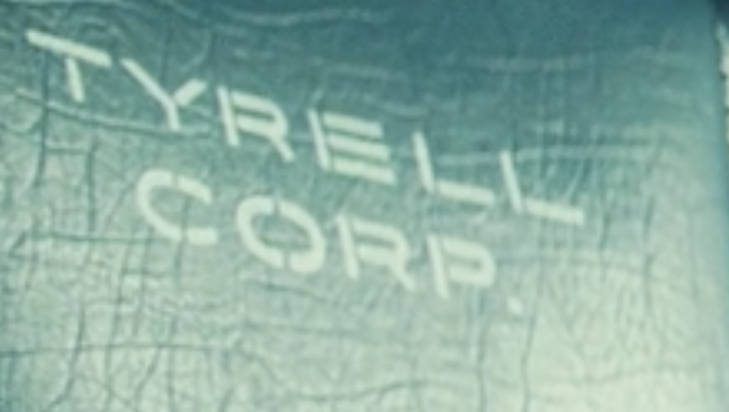
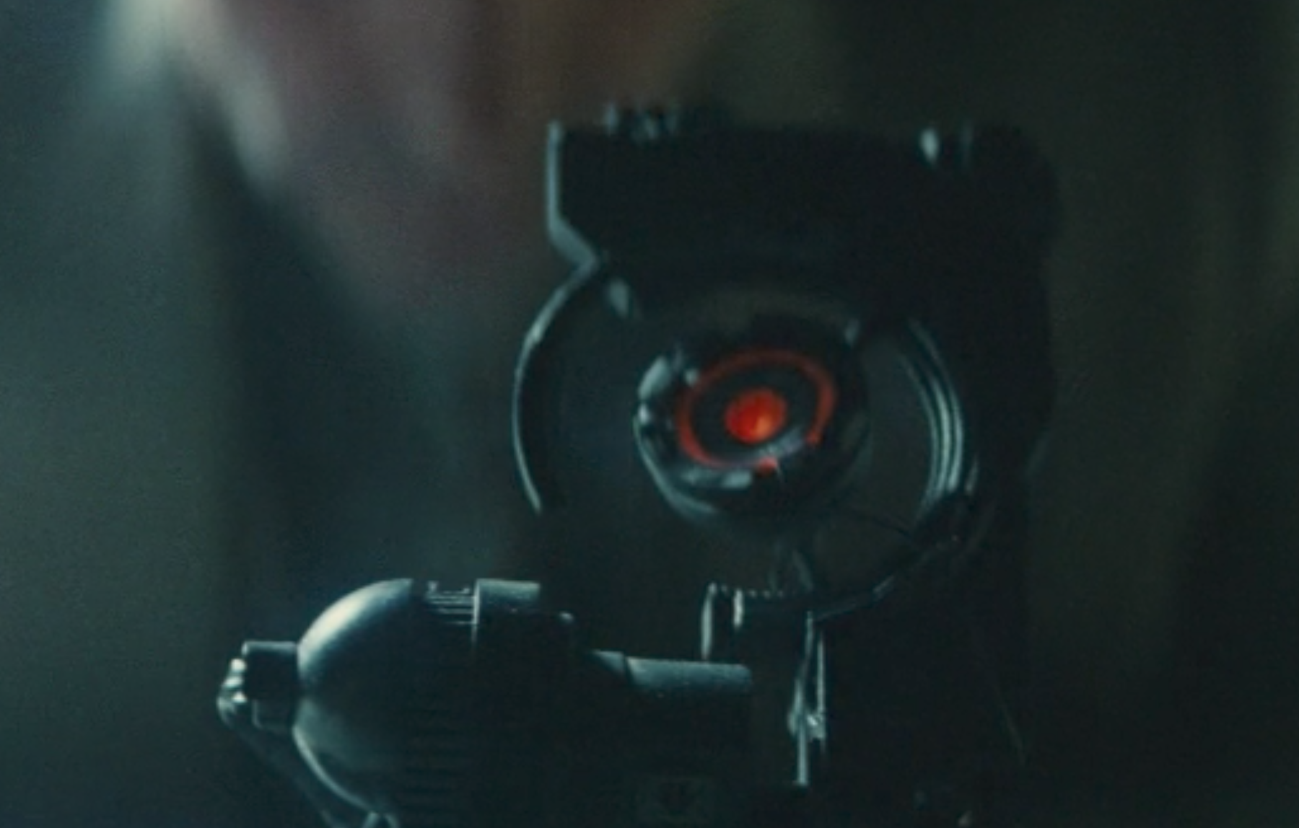
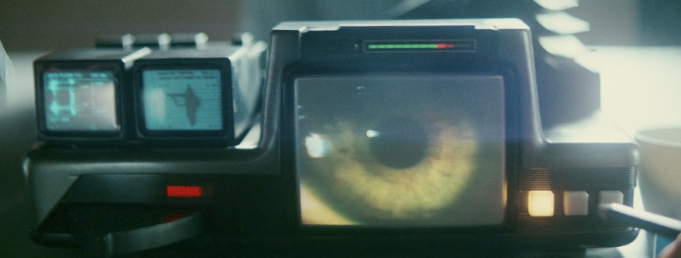
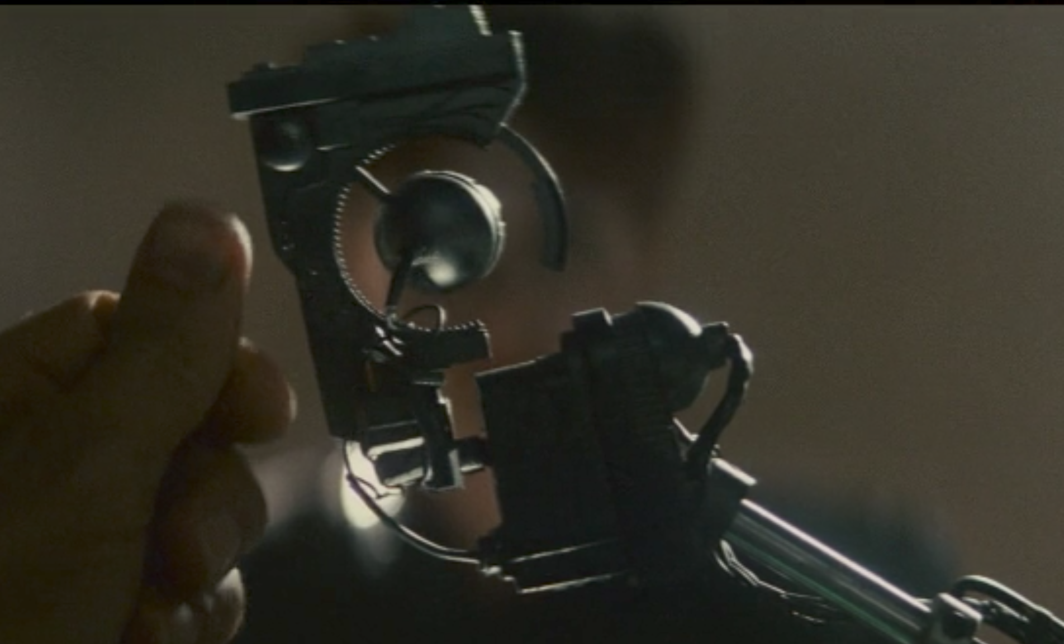
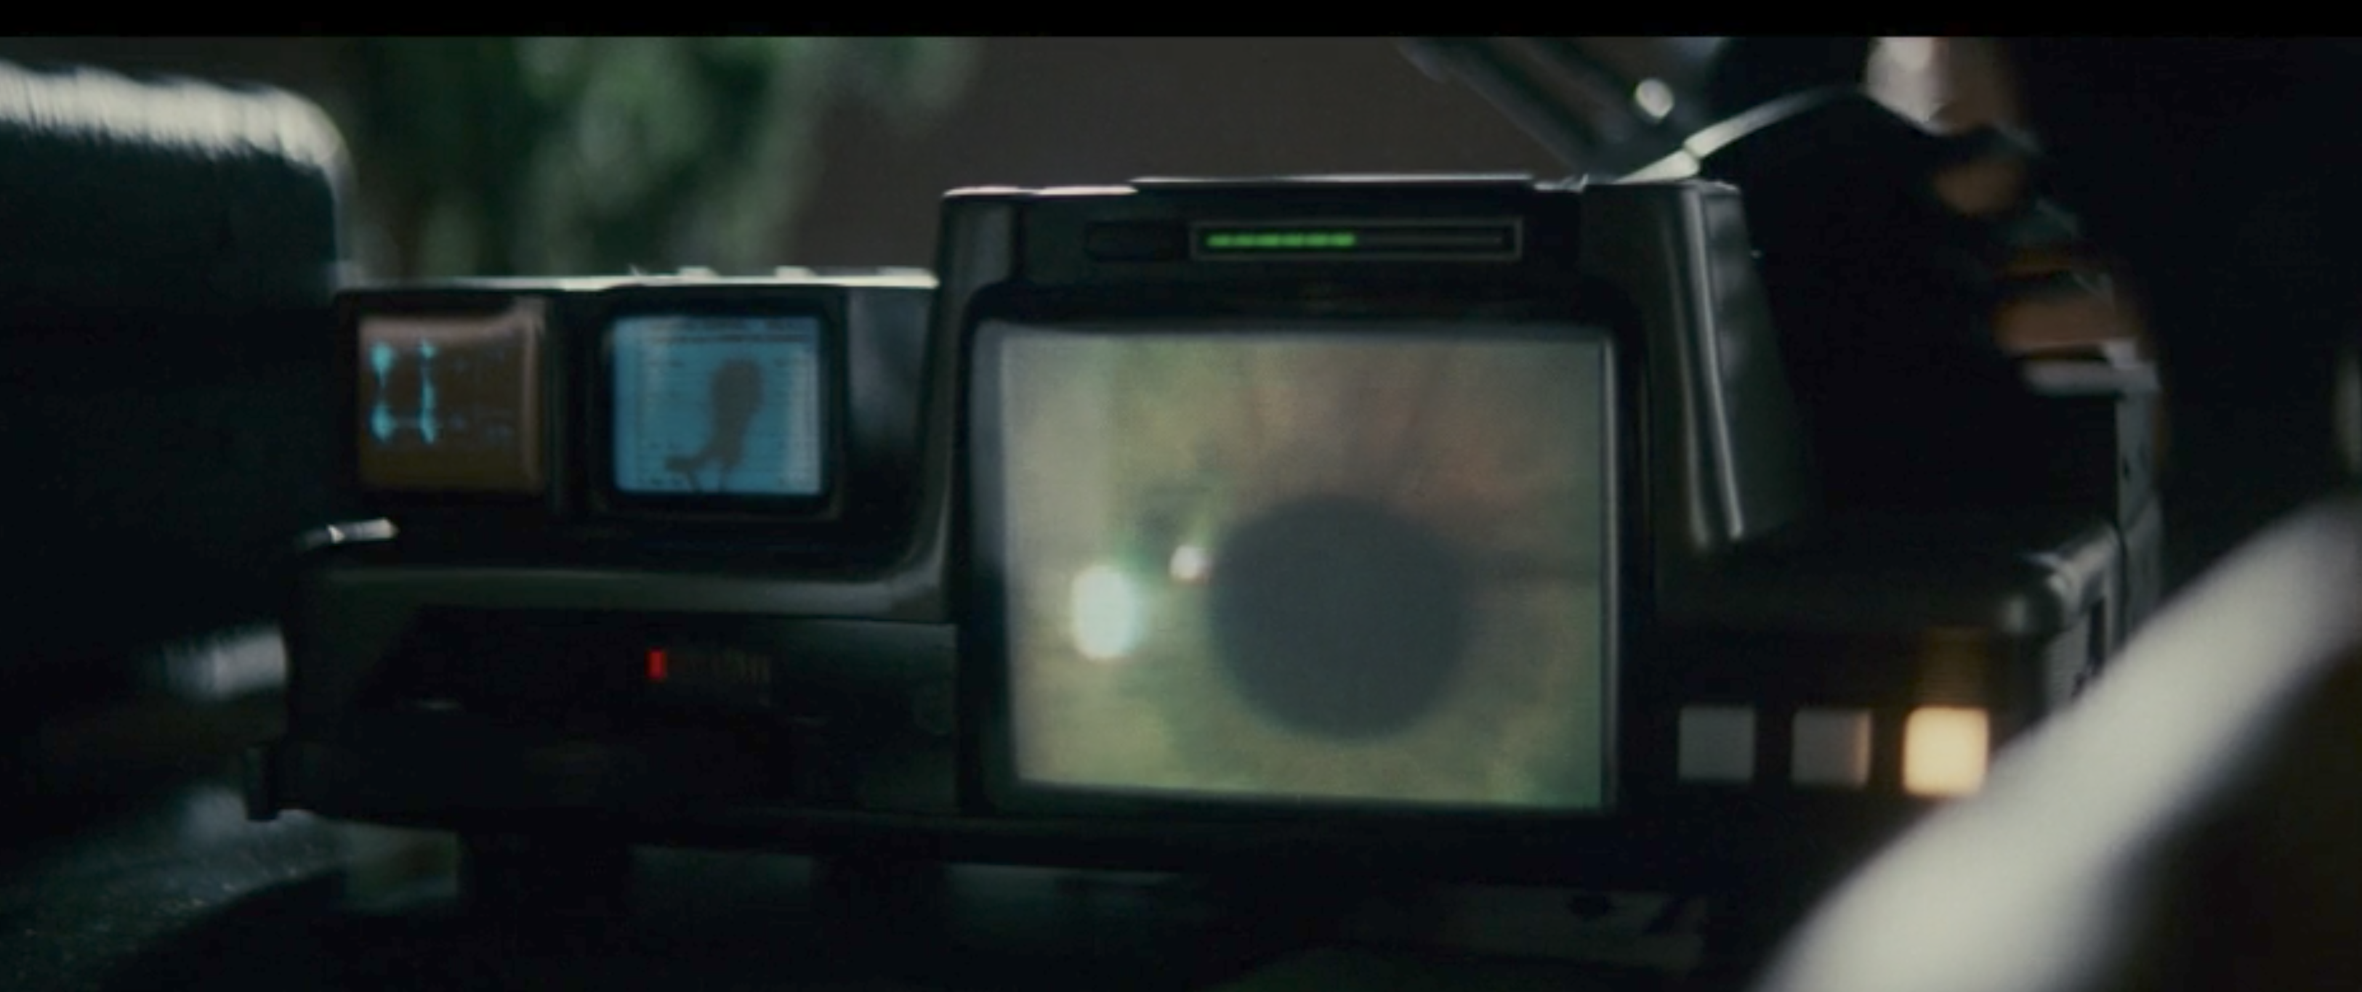

Slide 2
It’s a test to provoke an emotional response
Retirement not execution
A new life awaits you in the off-world colonies, the chance to begin again in the golden land of opportunity and adventure

Slide 3
159, 116, 73

